Slide 1
Encryption Devices

Slide 2
Overview
Encryption Devices
Simple Key Loader (SKL) AN/PYQ-10
TACLANE operation
KG175D & KG250X

Slide 3
Simple Key Loader (SKL) AN/PYQ-10

Slide 4
SKL Overview
Simple Key Loader (SKL) characteristics:
The SKL has three major components. They are the SKL, Battery, and Battery Pack Charger.
The SKL contains the Operating System (OS) software, Core Library software, SKL User Application Software (UAS), and the SKL Database.
It also houses the KOV-21 INFOSEC card which is CCI. This card along with the Crypto Ignition Key (CIK) provides the protection for the data stored in the SKL.

Slide 5
SKL User Application Software (UAS)
Transmit This function provides the user with a selection of ten different
Transmit functions.
Load This function is initiated from the Platform or Equipment tree at
any level within the tree. It is used to load ECUs.
Load Selected Keys
This function is initiated from the Key tree only. It is used to
load specific keys into ECUs.

Slide 6
SKL STEPS
Login (username and password will be created for you when you sign out the SKL from KMI)
Select “Core Lib”
Select Launch drop down
Select “Launch UAS”
***SKIP IF AUTO LAUNCH UAS IS ON**
Select and load Key
When selecting key ensure you selct the correct segment
Once key is selected you will see a load
Select protocol “DS 101”
If loading into a KG ensure to “send wake up”
Make sure you are “Filling” the key not “issuing”
Once all steps are completed you should see “key loaded successfully”

Slide 7
Hands on!
Hands on Time!

Slide 8
TACLANE Operation (KG-175D)

Slide 9
KG-175D Overview
KG-175D characteristics:
Capable of 100 Mbps upload/download.
Programmable Internet Protocol (IP) Information Security (INFOSEC) device with traffic protection, networking, and management features that provide Information Assurance services for IPv4 and IPv6 networks.

Slide 10
KG-175D Configuration steps
Initializing:
Initial login
Enable SSO
Switch t full configuration mode
Enable Secure Comm
Set Classification
Set Time and Date
Configure IPv4 Interfaces
IP routing and encryption:
Peer enclaves
Load Keys
Create PPK Key Chain
Configure Manual (PPK) Security Association (SA) Config

Slide 11
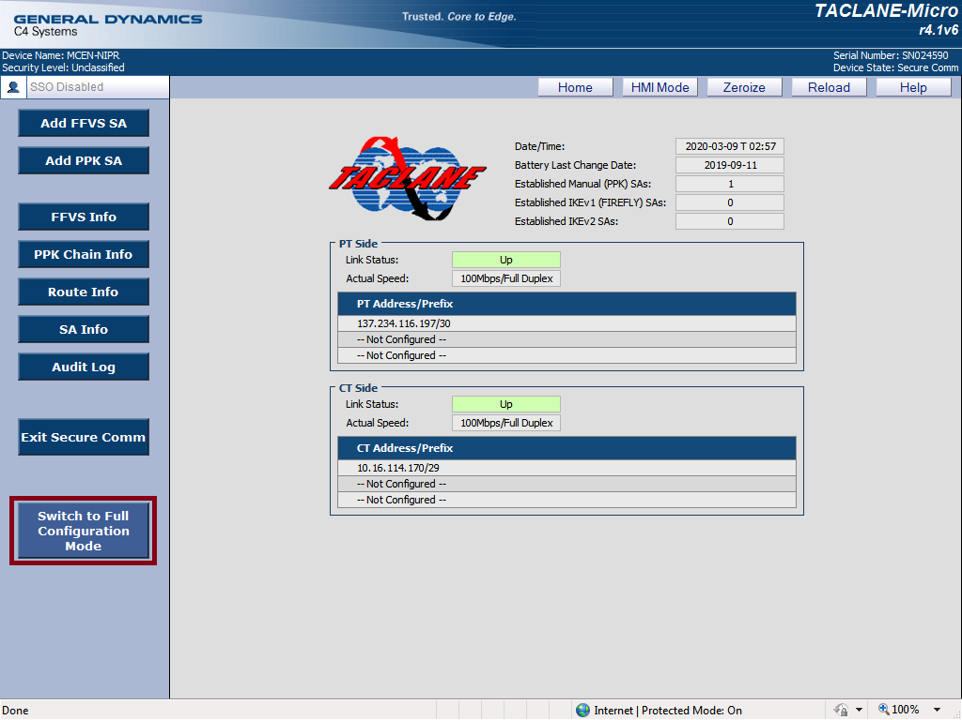
Initializing: KG-175 Initial Login
The default configuration for console access will be as follows: http://172.16.0.1
Configure CM with following:
IP Address: 172.16.0.2
Subnet Mask: 255.255.255.0
Default Gateway: 172.16.0.1
“Switch to Full
Configuration Mode”

Slide 12
Initializing: Enabling SSO
Enabling SSO: Before making any configuration changes required to set the TACLANE up, enable SSO which enters the administrator mode for TACLANES.

Slide 13
Initializing: Security Level
Setting Security Level: Now that SSO has been enabled, ensure the Security level has been set appropriately. In the configuration menu on the left, select and expand the “Operation” section and then select “Security Level”. This will take you to a page that looks similar to the following:

Slide 14
Initializing: Date and Time
Date and Time: Device time is important for a crypto sync to occur between TACLANES. When changing time, device will restart. To validate the date and time, navigate to and expand the “Maintenance” section and click the “Date/Time” option, as shown below:
Set date and time to “zulu time”
KG will restart once date and time is changed

Slide 15
Initializing: Configuring IPv4 Interfaces
IPv4 Interfaces: To configure the Plain Text and Cypher Text IPv4 addresses, navigate to and expand the “Network” section, “IPv4 Comm” option, as shown below:

Slide 16
IP routing and encryption: Local Encalve
Local Enclaves: Once the IPv4 interfaces have been configured, a local enclave route will automatically generate. This local enclave route reflects the connected PT interface.
To validate this route, navigate to and expand the networking section, then expand the “Routing” section and select “Local Enclave”. This should open a screen similar to the one:

Slide 17
IP routing and encryption: Peer Encalve
Peer Enclaves: Once the local enclave has been validated, it’s time to create a peer enclave. A peer enclave is a static route to a peer, or remote, TACLANE.
To navigate to the peer enclave configuration section, expand the “Network” section of the left hand menu, then expand “Routing”, select the “Peer Enclave” option as shown:

Slide 18
IP routing and encryption: Keys and Key Chains
Coordination with the local KMI manager will need to occur to ensure you receive the correct key material to load into each TACLANE. It is important to note that there are two types of keys used and there are slight differences between the keys. These keys are as follows:
Pre Placed Keys (PPK): Pre-placed Keys, or PPK, are the keys used to fill the TACLANES. These keys will need to have the same short title as the key that is present on the TACLANE you are connecting to. These keys change monthly so a crypto rollover might be required if the exercise lasts longer than the valid end date of your PPK. This date can be validated within the Simple Key Loader (SKL) when displaying the key information.
Firefly Vector Set (FFVS): Firefly vector sets are also used to fill the TACLANES and these keys will have a matching short title with a unique ID appended to the end of the short title. Each firefly key must be unique and can only be used once, but these keys last for a year at a time.

Slide 19
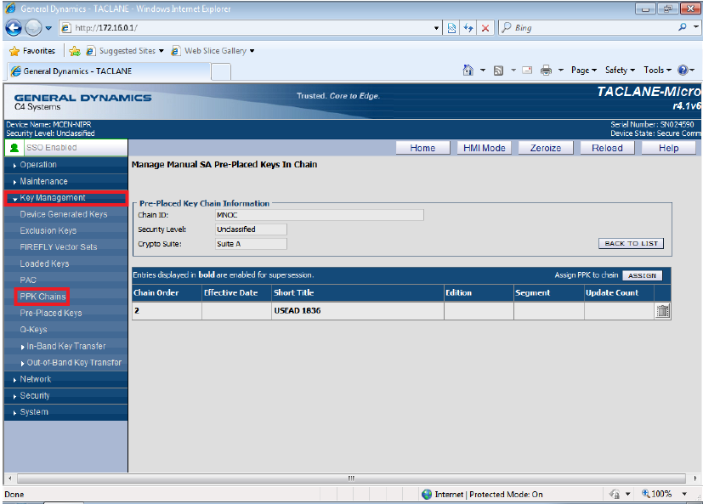
Loading the Key
Once the key is loaded navigate to the Key Management drop down and select pre placed keys. Once there you should see a window similar to the photo below. select the pencil on the right hand side to edit the key information. Ensure to set the “USAGE TYPE” to “Traffic” and set the “COI” to “US”. A description is optional.

Slide 20
IP routing and encryption: PPK Chain
After loading the Key, create a new keychain. Navigate and expand the “Key Management” section within the left hand menu and select “PPK Chains” from the sub-options. Once there, select create and you should see a window similar to the photo below:
When creating the PPK chain, you will have the option to select the PPK you loaded and click “Assign” to add the PPK to the Keychain. If you are online when a crypto rollover is occurring, you will:
1.) Load the new PPK into the TACLANE.
2.) Navigate back to this keychain.
3.) Select edit, highlight the key and click “Assign”.
This will add the new key to the keychain. This will prevent a disruption of services when the old key expires and the new key takes effect.
It is important to note, that from this point forward, if you delete the PPK Keychain at any point, THIS WILL DELETE THE PPK AND YOU WILL HAVE TO REFILL THE TACLANE!

Slide 21
IP routing and encryption: Manual (PPK) SA Config
The final configuration required will apply only to the PPK Keys. Once you have a PPK Keychain configured, navigate to and expand the “Security” tab. From here, select the “Manual (PPK) SA Config” option and you should see a screen similar to the one below:

Slide 22
IP routing and encryption: Manual (PPK) SA Config
Once here, select “Create” and you will be taken to a window similar to the one below:
Pay attention to the Remote IP addresses. Marines tend to reverse the IP’s
Under Key Details ensure to select transform suite “SuiteA(MEDLEY/GCM-96)”
*NOTE* If you don’t select this transform suite you will have to delete and refill the key and do the previous steps over again.

Slide 23
Questions
?

Slide 24
Hands on!
Hands on Time!

Slide 25
TACLANE Operation (KG-250X)

Slide 26
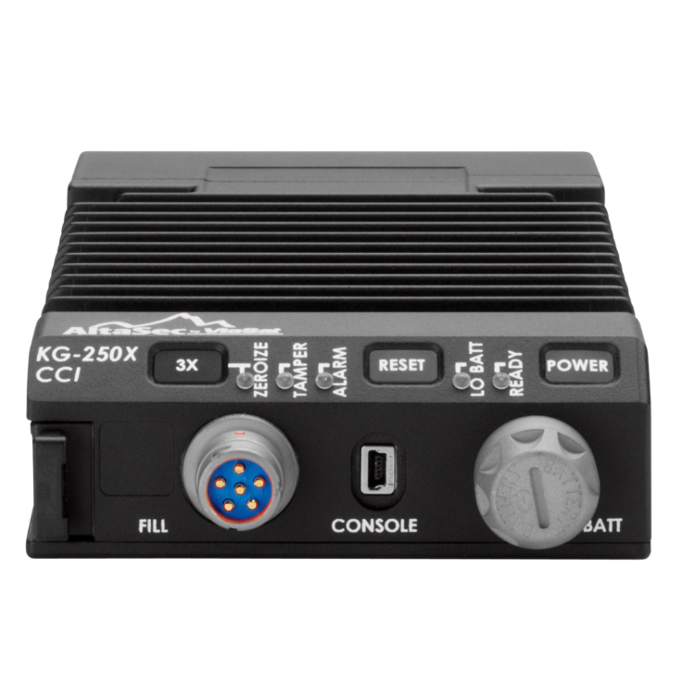
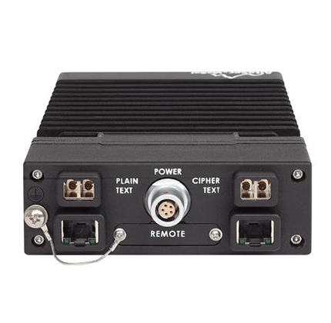
KG-250X Overview
KG-250X characteristics:
The Viasat KG-250X/KG-250X-FC (fiber copper) is a rugged, flexible, low-size, weight, and power (SWaP), high-speed National Security Agency (NSA)-certified Type 1 Inline Network Encryptor (INE).
It protects Top Secret/Sensitive Compartmented Information (TS/SCI) and uses the latest technologies and software to provide the network security tactical and mobile users rely on.

Slide 27
KG-250X Configuration steps
Initializing:
Initial login
Configure management accounts for the TACLANE
Provisioning the CIK with the Necessary Classification
Configuring the Date and Time
Configure IPv4 Interfaces
IP routing and encryption:
Local Routes
Keys and PPK Sequences
Remote route configurations
Ping Tests

Slide 28
KG-250X Initial Login
The default configuration for console access will be as follows: http://192.168.1.1
Configure CM with following:
IP Address: 192.168.1.2
Subnet Mask: 255.255.255.0
Default Gateway: 192.166.1.1
For this step, ensure you are using a configuration management (CM) laptop for initial configuration. You will plug directly into the PT interface initially. Once the PT interface is properly configured and on the network, the TACLANE can be managed remotely by any device on the PT network via the GUI ip (User Laptop)
Please keep in mind that if you changed your PT interface, you will need to ensure your CM IP information is updated to be on the new network if you are plugged directly in to the PT interface. Also ensure that you do NOT plug a configuration management (CM) laptop into the PT interface while the CT interface is actively connected to your claissified network! This could lead to your CM becoming classified.

Slide 29
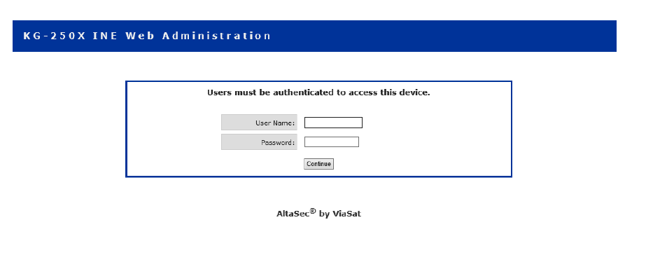
KG-250X Initial Login
Once you GUI into the TACLANE, it should bring up a page similar to the one shown below:
The default credentials for the web/console access is as follows:
Username: admin Password: changeme

Slide 30
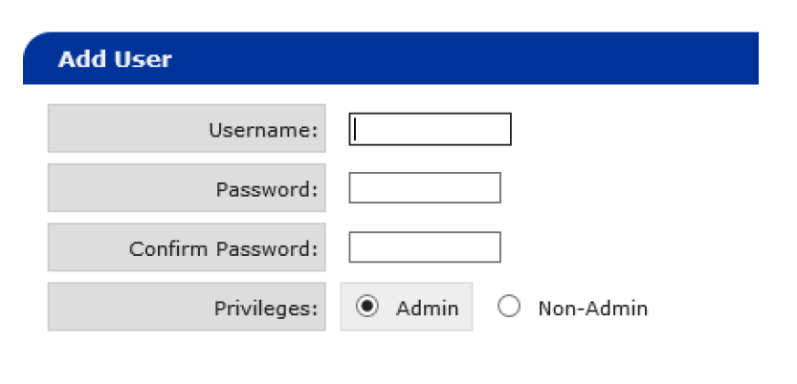
You will be asked to change the admin password as soon as you log in. You will also be asked to change the “snmpadmin” password. The old or default password is also “changeme”. NOTE: The DoD requires the default account to be deleted, and a different administrator account is created for each individual that will be managing the device. To create a new administrator account, login using the default account and then navigate to “User Administration” under the “Utilities” tab on the left panel of the management GUI. You will see an “Add User” section, and here you will create an individual account for each manager entering a username and password. Also, ensure the “Privileges” section is set to “Admin”. Each administrator will need to configure their own TACLANE accounts and the username format should be first initial followed by last name as shown below: Name: John Doe TACLANE account username: jdoe
Configure management accounts

Slide 31
Provisioning the CIK
The KG-250Xs function differently than the KG-175Ds in regards to setting the device classification level. The KG-250X classification is determined when the CIK for the TACLANE is provisioned and cannot be changed unless it is completely provisioned again. It is recommended that you determine initially which TACLANE will support each enclave and ensure this is annotated for future configurations/operators.
If the TACLANE is not default, you can determine its classification by navigating to “CIKs” under the “Key Configuration” section on the left side of the management GUI. You will see the CIK you currently have inserted and there will be a “Security Classification” section that will display the classification level.

Slide 32
Provisioning the CIK
If the TACLANE CIK has not been provisioned or you zeroized the CIK, you will need to follow these steps:
1. Acquire the kg250x_v2.iwks Image Key File. Your local KMI Manager should be able to get this file for you. Alternatively, you can find this file within the “KG-250X r5.0.48 Upgrade Zip” file located on the Navy Infosec portal at the following address:
NOTE: The above mentioned filename may not be exactly the same.
https://infosec.navy.mil/crypto/index.jsp?Topic=ine&d=KG-250X
Ensure the file is on the computer you are managing the TACLANE from.
2. Login to the management GUI with an administrator account.
3. Navigate to “CIKs” under the “Key Configuration” section.
4. Name the CIK under the “CIK Label” section. This can be anything you want, but it is recommended you use the enclave this TACLANE will support (NIPR, SIPR, CXK, etc).
5. Select the Classification Level. Refer to the list above to ensure you select the right level.
6. Next, you will select the Suite to be used. This will always be “Suite A – UNITED STATES”
7. Browse your computers directory and find the kg250x_v2.iwks file that you acquired earlier.
8. Finally, click the “Provision CIK” button. Wait about 60 seconds and refresh the page and ensure the CIK now displays the proper provision settings.

Slide 33
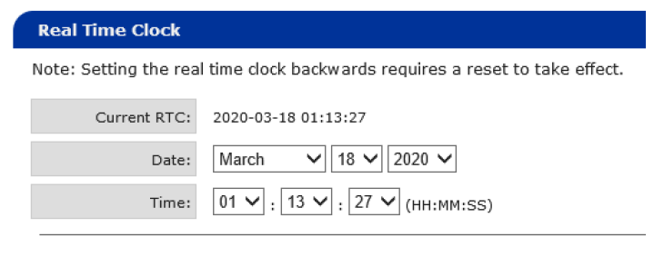
Configuring the Date and Time:
Device time is important for a crypto sync to occur between TACLANES. To validate the date and time, navigate to “Utilities” and then select the “Real Time Clock” section.
Set the time of your TACLANE to match current Zulu time and save the change. As indicated in the above photo, if you are setting the time backwards, the TACLANE will need a reboot for changes in time to take effect. Any change in time going forward in time will not require a TACLANE reboot.

Slide 34
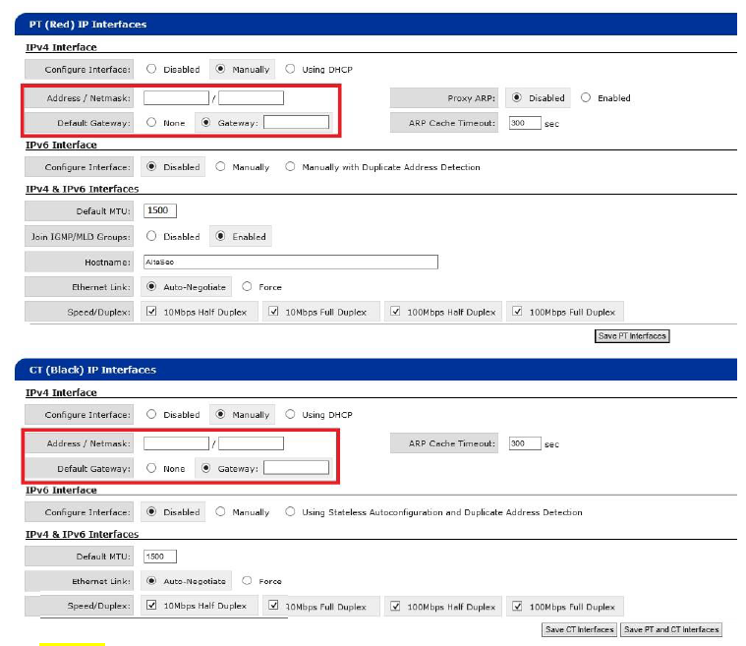
Configuring IPv4 Interfaces:
Next, navigate to “Network Configuration” and select the “IP Interfaces” section. This should bring up a page similar to the one shown below:
NOTE: The red boxes are the areas that will require configuration. Everything else displayed are the default TACLANE values and should be left at their default values.
validate that the MTU field for both the CT and PT are defaulted at 1500. If you see any other number in the MTU field, default it back to 1500. Once you have validated all of these settings, click “Save PT and CT Interfaces”. The TACLANE will need to be restarted for the changes to take effect.

Slide 35
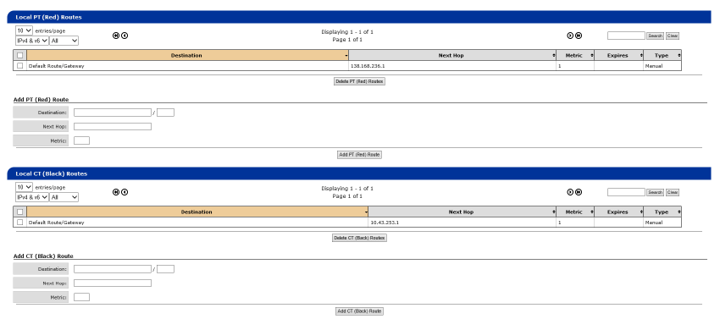
Local Routes
This local enclave route is basically a static route to direct traffic from the TACLANE PT interface to its configured gateway on the router.
These should automatically populate once the previous step has been completed

Slide 36
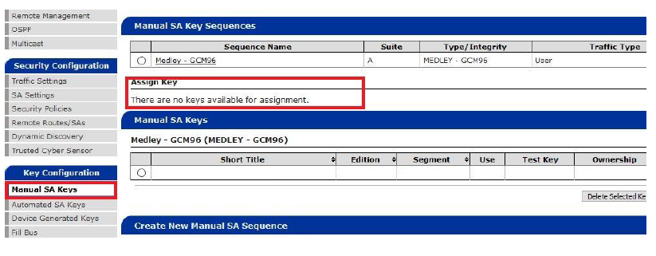
Keys and PPK Sequences
To load keys onto the KG-250X from an SKL, you will want to navigate to the appropriate key, select it, and then select “File -> Transmit -> Load”. You will want to make sure your protocol and activation mode are set to “DS-101” and that you uncheck the boxs for “Send Wakeup” and “Send Tag”. If successful, you should see the process complete on the SKL. You should also be able to navigate on the TACLANE to the following section to see a key ready to be assigned:
Key Configuration -> Manual SA Keys

Slide 37
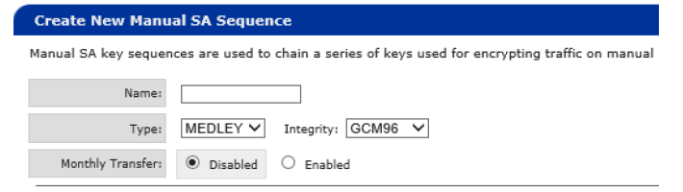
Keys and PPK Sequences
Next, navigate to “Key Configuration” and then the “Manual SA Keys” section. If you do not have a sequence created already, it will look something like this:
You will create the actual PPK sequence as follows:
1. For the name you can use anything desired, but it is recommended you use the enclave being utilized (Unclassified, classified etc).
2. The type will be set to MEDLEY!
3. The Integrity will be set to GCM96.
4. Monthly Transfer will be disabled.
5. Finally, click the “Create PPK Sequence”.
Next, you will assign the PPK to the newly created PPK sequence. You will see the PPK still under the “Unassigned Pre-Placed Key (PPK) List”. Ensure the month and year selected is correct for the PPK you are utilizing, and then select the sequence you created and add the PPK. If you are assigning multiple keys to the sequence, follow the same steps and ensure the “Key Supersede” button is selected for automatic failover once that key takes over.

Slide 38
Remote Route Configurations
Remote Routes on a KG-250X function a lot like the Peer Enclaves for the KG-175Ds. Remote routes are basically static routes where the next hop is the distant-end TACLANE you are attempting to peer. In order to add a Remote Route, navigate to “Security Configuration” and then select the “Remote Routes” section. You should see a portion of the screen similar to below:

Slide 39
Remote Route Configurations
To configure the Remote Route, follow the steps below:
1. Destination Name. Recommend using “Default Route to CBS”.
2. Destination: The destination/prefix will be located on your cutsheets
3. Since you have not created an SA yet, you will select the “New SA” radio button, and reference your cutsheets for the correct distant-end CT and PT IPs based on the transport you are using (NIPR Transport or BlackCore).
4. Route Metric: 1
5. Security Association: Select “Manual” and make sure you have “MEDLEY (MEDLEY – GCM96)” selected from the dropdown.
6. Leave the “Auto SPI” box checked.
7. Select “Add Remote Route and SA”.

Slide 40
Validation Ping test
Unlike the KG-175D, when validating your connection to the CBS via a ping test, you will ping from the corresponding interface (PT/CT) instead of sending all pings via the CT interface.
To do this, navigate to “Utilities” and select “Ping”. You should see a screen similar to the one below:
When selecting PT: The TACLANE will send a ping with the source address as the configured PT (Red) interface address. The ping will be sent on the locally connected PT network, or across a secure tunnel should the destination exist behind a remote TACLANE.
When selecting CT: The TACLANE will send a ping with the source address as the configured CT (Black) interface address. The ping will be sent on the locally connected CT network.

Slide 41
Questions
?

Slide 42
Review
Encryption Devices
Simple Key Loader (SKL) AN/PYQ-10
TACLANE operation

Slide 43
Hands on!
Hands on Time!

